Slide 1


Targeting New Home Buyers with Amazon and Realogy
By: Andy Martin del Campo

Slide 2
Amazon and Realogy Partnership
Amazon will provide leads to Realogy through a program called TurnKey
Homebuyers in return will receive up to $5,000 in free services from Amazon
Smart Home Devices
House cleaning
Maintenance
General handy-man service

Slide 3
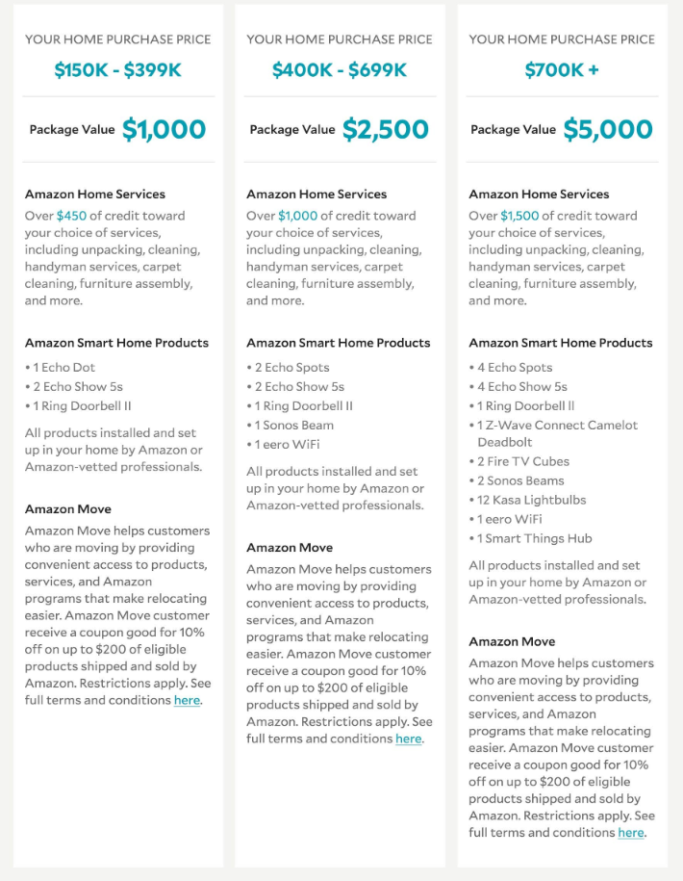
Terms
https://www.amazon.com/adlp/turnkey?tag=curbed-20

Slide 4
Where does the King County Housing Data fit?
The higher the price of the house, the bigger the amazon package.
Amazon wants its devices in your house.
Suggest future purchases
Gather more data
What information is most important to land bigger buyers and generate better leads?

Slide 5
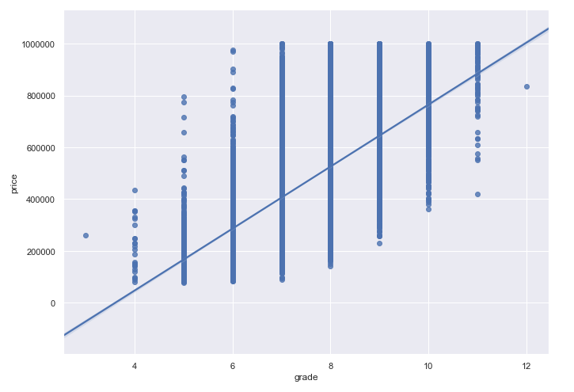
Grade
Grade is the quality of the house
The higher the grade, the better materials and features of the house.
If you know the grade, you can determine intevals for pricing

Slide 6
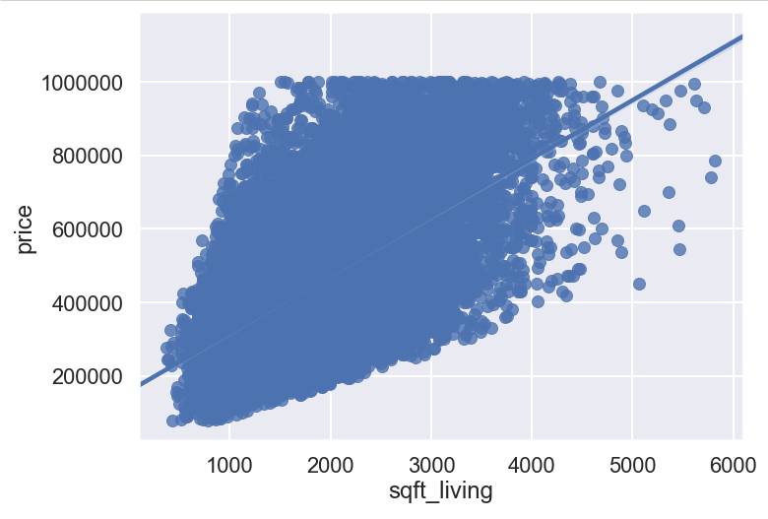
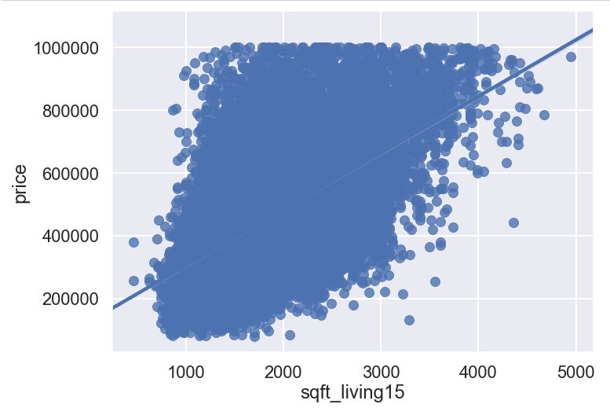
Sqft of Living Space and neighbors
The overall size of the house and the surrounding neighbors.
Simple to understand. The bigger the house, the higher the price generally.

Slide 7
Why this matters
Knowing these three housing features. You can generally predict the selling point of a house and if it is sold through the TurnKey program Amazon will be able to provide its services.
You will be able to estimate services available for specific houses in advance of them selling.

